Slide 1


Customer Churn Prediction and Management
Internship Project at Ericsson Global Services
Name: Debanjali Saha
Roll No.: 1810110059
Degree: B.Tech. in ECE
Role: IT Development Intern at R&D unit

Slide 2
Understanding Churn

Slide 3

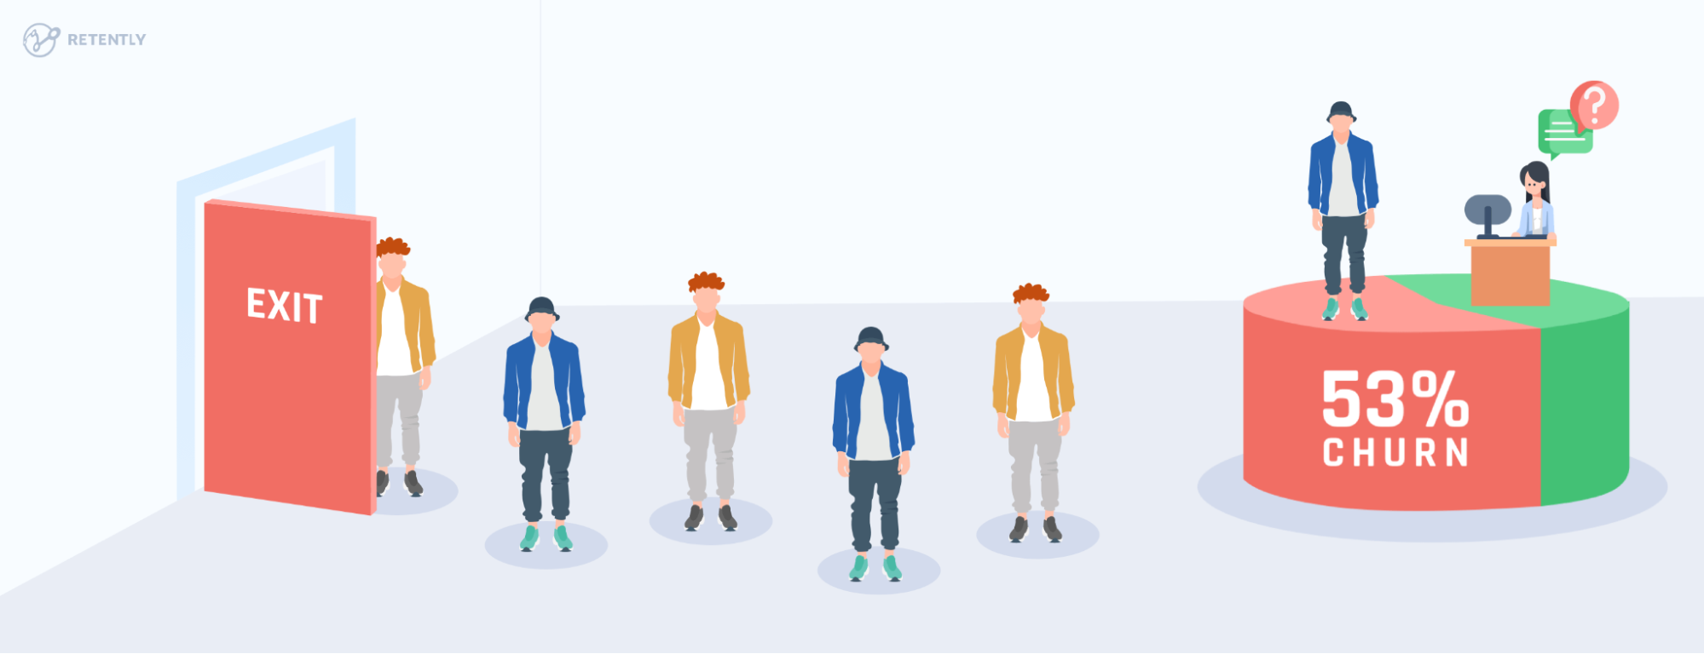
WHAT IS CUSTOMER CHURN?
WHY IS CUSTOMER CHURN IMPORTANT?
Also known as Customer Attrition. The phenomenon wherein a customer (or subscriber) decides to discontinue the usage of a product or a service from a company or business.
According to research done by Bain & Company, it can cost five times more to attract a new customer than
it does to retain an existing one. Increasing customer retention rates by 5% can increase profits by 25% to 95%.
The reasons that lead customers to the cancellation their plans can be numerous, coming from poor service quality, delay on customer support, prices, new competitors entering the market, and so on. Usually, there is no single reason, but a combination of events that somehow culminated in customer displeasure.
A customer, upon churning, leaves something extremely valuable behind: the data. This data can give very good clues about where the company left to be desired. It can be a valuable source for meaningful insights and to train customer churn models, learn from the past, and have strategic information at hand to improve future experiences. When it comes to the telecommunications segment of the industry, there is great room for opportunities. The emergence of sophisticated artificial intelligence and data analytics techniques further help leverage this rich data to address churn in a much more effective manner.

Slide 4
PROBLEM STATEMENT

Slide 5
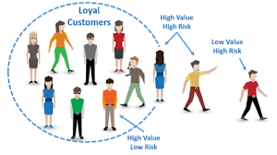
CUSTOMER LIFETIME VALUE AND LOYALTY
Churn is the proportion of subscribers who leave the network. Customer churn causes a direct loss of revenue to a business. Operators must be able to retain their customer base and minimize churn.
To enable this, one of the important tasks is to identify the customers who are likely to churn and organize them in groups with priority so that preventive measures can be taken along with estimating and analyzing the amount of revenue the customer is likely to generate in his lifetime (CLTV)and hence build a strategy to retain them.
The entire process of managing churn involved numerous activities – data preparation, model training, model scoring and visualization, planning and implementing strategies of marketing, and so on.
Customer loyalty is something all businesses strive for and so, understanding and preventing churn is critical to achieving this.

Slide 6
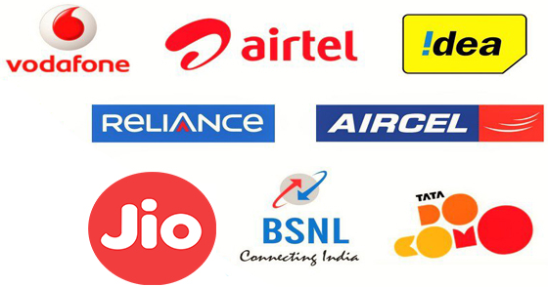
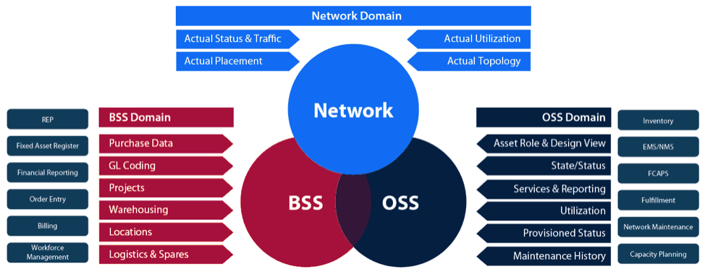
AIM AND OBJECTIVE
A BSS (Business Support System) is a component used by TSPs
(Telecommunication Service Providers) to run their business operations towards
customers. The term is used to broadly describe customer-facing functionalities for a business.
The tools which are a part of BSS allow organizations to connect with their customers (like CRM or Customer
Relationship Management), create offers for customers (like products or services), take orders from customers, tackle payment issues (billing and rating), revenues, etc.
Ericsson develops such consumer telecom BSS stacks for CSPs (Communication Service Providers) enabling them to monetize the network as a platform; serve enterprise customers; facilitate ecosystem partners; support dedicated networks, IoT platforms, connectivity, communication, and collaboration.
The aim of this project is to apply AI-enabled personalization to the application of Retention Policies to reduce customer dropout. This is the next step in automating the process of identification and solution to Customer churn.
The aim is to find the specific survival time of a customer and prospective date of churn with the highest possible performance and automate this complex and highly subjective task of detecting “churners” and finding out how long they will survive for.
The currently defined and suggested method to be used for the project is Survival Regression to analyze the expected duration after which a customer will churn and combine this with machine learning models to get optimal results upon experimentation. Thereafter, the results are to be explained using “Explainable AI” with SHAP.

Slide 7
WORK DONE

Slide 8
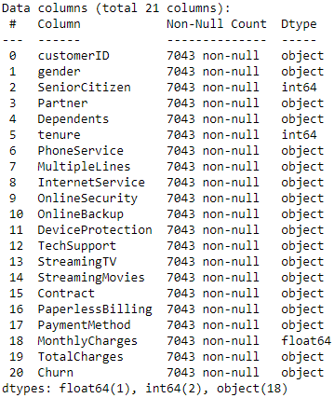
DATASET INFORMATION
The churn dataset preparation job would scan records of customers who already have churned, take a certain number of random snapshots of past behavior of the same population and combine it with a population of active customers of size certain times that of churned population. For a demonstration of the actual work done which is non-disclosable as per the Code-Of-Business-Ethics at Ericsson, this report explains all the R&D done with open-source Kaggle Dataset called Telco Customer Churn.
The first step is to import the data and perform some basic cleaning.
For each customer, we will need two important data points:
'Tenure': how long they have been a customer when the data is observed
'Churn': whether or not the customer left when the data was observed

Slide 9
DATA PREPROCESSING
We will first identify the output features and ensure the data type of all features is correct.
It is extremely important to note here that many customers in our data have not churn yet which means that the dataset is Right-Censored.
We drop the columns which are not of any use to our use-case.
We deal with missing values in the dataset.
We change object data types to float/int/binary(boolean)/multi-class(one-hot encoded) as per the data present as each feature.
Libraries used:
Lifelines
Numpy
Pandas
Matplotlib

Slide 10
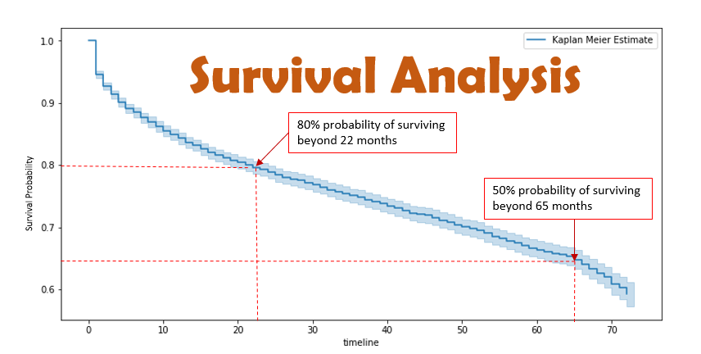

THE TOOL: SURVIVAL ANALYSIS
Also known as “Time-to-event Analysis”.
Survival analysis is a branch of statistics for analyzing the expected duration of time until an event occurs, such as death in biological organisms and failure in mechanical systems, or churn in our use-case.

Slide 11
WHY USE SURVIVAL ANALYSIS?
Survival analysis was first developed by actuaries and medical
professionals to predict survival rates.
Survival analysis works well in situations where we can define:
A 'Birth' event: for our application, this will be a customer entering a contract with a company
A 'Death' event: for us, 'death' is a customer ending a relationship with a company
The component that makes survival analysis superior to other regression models is its ability to deal with censorship in data.
In the traditional sense, censorship may refer to losing track of an individual or an individual not dying before the end of an observation period. This data is 'censored' because everyone dies eventually, we're just missing the data. Similarly, we would expect to lose all customers eventually. Just because we haven't observed them canceling their contact, doesn't mean they never will.
Moreover, other methods like Logistic Regression are only helpful in predicting whether churn will occur or not i.e. for binary classification.

Slide 12
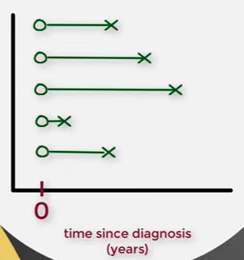
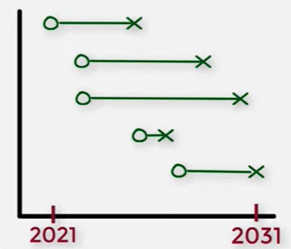
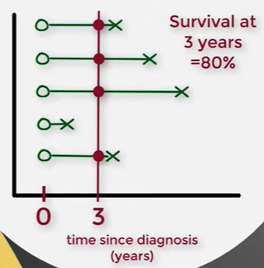
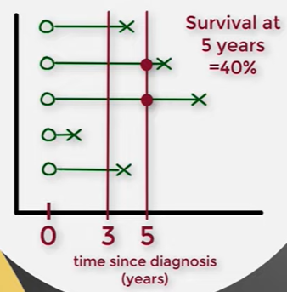
THE FIRST STEP
At the end of 3 years, ⅘ patients survived and hence survival rate is 80%.
At the end of 5 years, ⅖ patients survived and hence the survival rate is 40%.

Slide 13
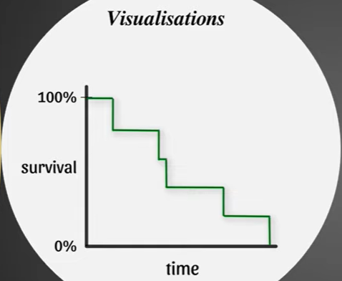
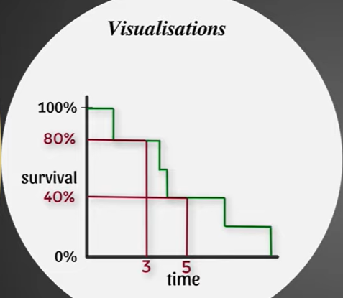
KAPLAN-MEIER CURVE (KM GRAPH)
1 CHURN => survival rate dips down by 20%
(because 5 people in sample and ⅕ has churned)
Non-parametric curve

Slide 14
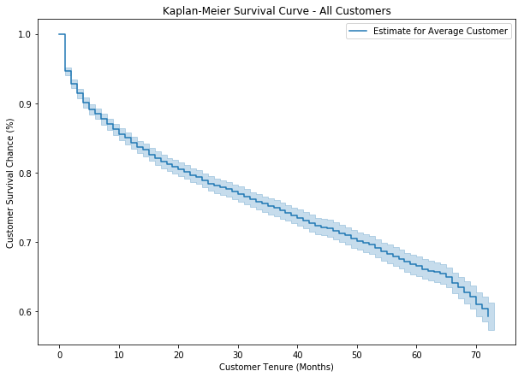
IMPLEMENTATION ON ENTIRE DATA
The Kaplan–Meier estimator, also known as the product limit estimator, is a non-parametric statistic used to estimate the survival function from lifetime data.
As we would expect for telecom, churn is relatively low. Even after 72 months, the company is able to retain 60% or more of their customers.

Slide 15
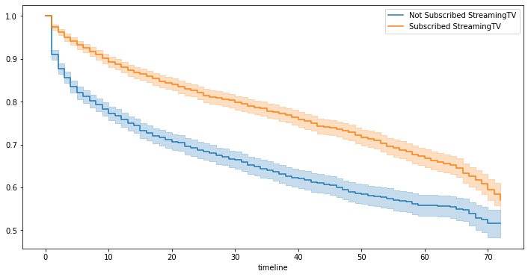
IMPLEMENTATION ON COHORTS
2 cohorts of customers are created based on whether a customer has subscribed for Streaming TV or not. We want to know that which cohort has the better customer retention.
It is evident that the customers, who have subscribed for the Streaming TV, have better customer retention as compared to the customers, who have not subscribed for the Streaming TV.
We can see that the survival probability of the cohort in blue is less than the cohort in red. For the cohort in blue, the survival probability is decreasing with high rate in first 10 months and it gets relatively better after that; however, for the red cohort, the rate of decrease in survival rate is fairly constant. Therefore, for the cohort , which has not subscribed for the Streaming TV, efforts should be made to retain the customers in first 10 volatile months.
We see that those who are not subscribers of streaming TV have highest probability to churn.

Slide 16
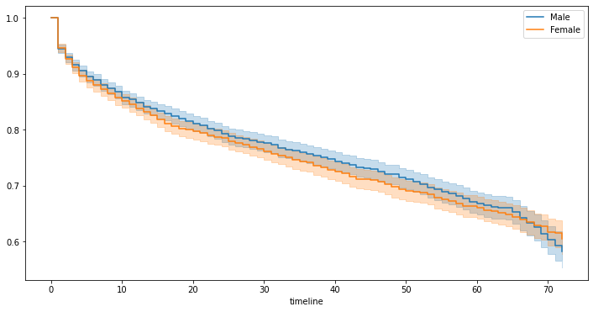
MAKING RECOMMENDATIONS
How can our telecom company reduce customer churn?
We can make recommendations along three dimensions:
(1)contract specification
(2)customer selection
(3)payment systems
To visualize some of our findings, we fit categorically based Kaplan-Meier curves and plot them, allowing us to see difference in churn rate between customer categories.

Slide 17
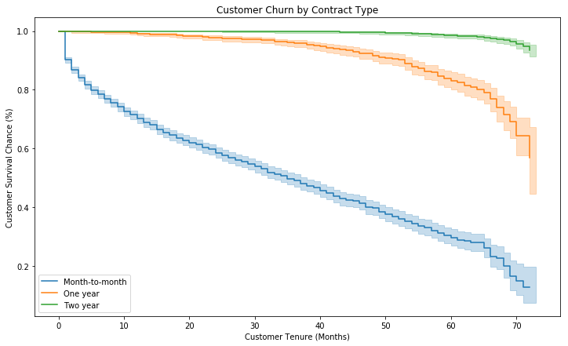
(1) Contract Specification
The most important feature, by far, is the presence of a 1 or 2 year contract. Customers are .25 and .02, respectively, times as likely to cancel their service if they are under contract.
Cancellation fees are a possible underlying cause. As long as these fees do not prohibit new sales, we would recommend continuing to put them into as many contracts as possible.

Slide 18
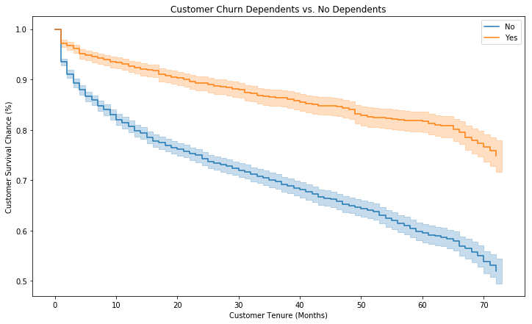
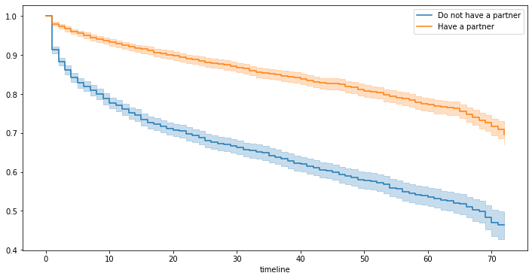
(2) Customer Selection
Customers with a partner or dependents are .82 and .91 times as likely to cancel as normal customers.
Families and other large households seem to be less likely to change providers.
This could be due to higher incomes, less time to consider options, or another combination of factors.

Slide 19
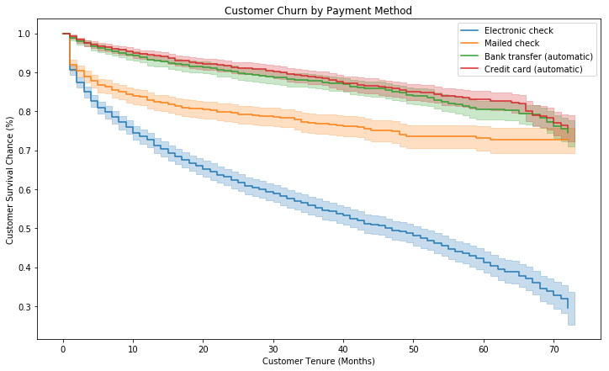
(3) Payment Systems
The recommendation is to make sure your customer’s default is an automatic payment made monthly. This requires little effort from the customer to remain subscribed.
Conversely, sending a check, in the mail or electronically, is a pain. It requires effort to remain subscribed.

Slide 20
COX PROPORTIONAL HAZARD MODEL
To examine the effects of different features, we will use the
Cox Proportional Hazards Model. We can think of this as a
Survival Regression model.
‘Hazards’ can be thought of something that would increase/decrease chances of survival.
In our business problem, for example, a hazard may be the type of contract a customer has. Customers with multi-year contracts probably cancel less frequently than those with month-to-month contracts.
After some data cleaning, including encoding categorical variables (k-1 dummies), we can fit a survival regression model to the data.

Slide 21
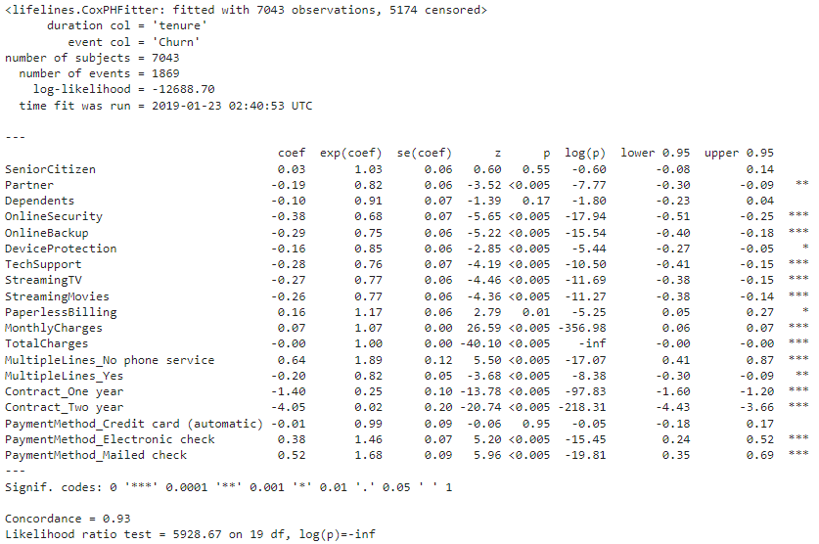
COX MODEL SUMMARY
The key output is exp(coef). This is interpreted as the scaling of hazard risk for each additional unit of the variable, 1.00 being neutral.
For example, the last exp(coefficient), corresponding to PaymentMethod_Mailed check, means a customer that pays by mailing a check is 1.68 times as likely to cancel their service.
For the company, exp(coef) below 1.0 is good, meaning a customer less likely to cancel.
To better visualize the above, we can plot the coefficient outputs and their confidence intervals.

Slide 22
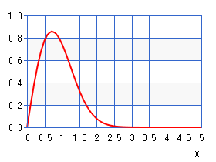
WEIBULL AFT + XGBOOST
A typical Weibull distribution:
Telecom Customer Churn is known to follow the Weibull Distribution on the basis of past research and analyses.
In the statistical area of survival analysis, an accelerated failure time model (AFT model) is a parametric model that provides an alternative to the commonly used proportional hazards models. Whereas a proportional hazards model assumes that the effect of a covariate is to multiply the hazard by some constant, an AFT model assumes that the effect of a covariate is to accelerate or decelerate the life course of a disease by some constant.
Probability
Time

Slide 23
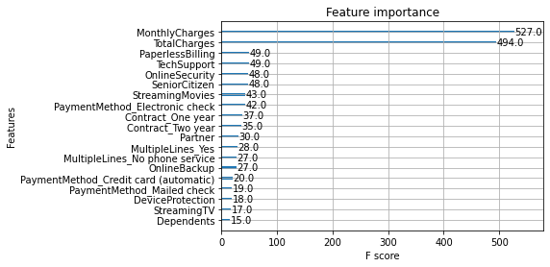
WEIBULL AFT + XGBOOST
From the XGBoost model, we find the following:

Slide 24
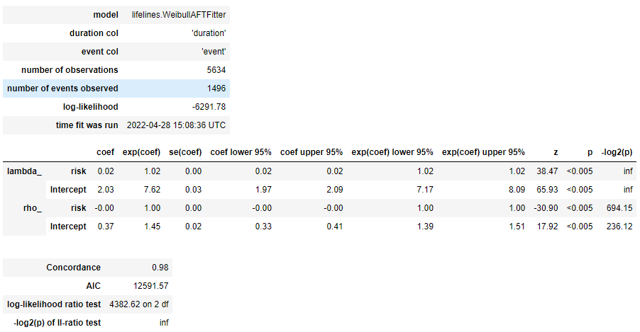
WEIBULL AFT + XGBOOST
We take the output from XGBoost model and fit it into
a Weibull Distribution to obtain an AFT regression:

Slide 25
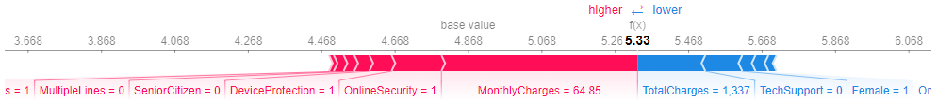
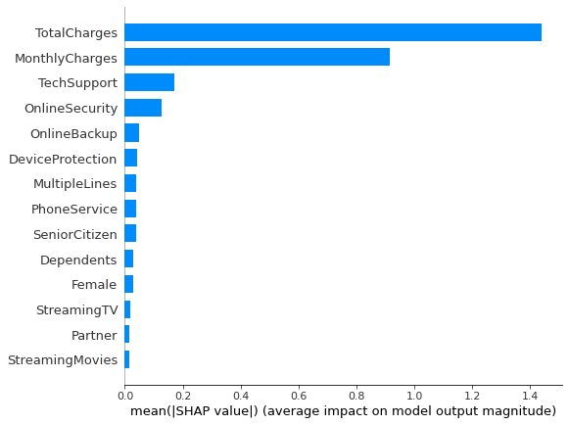
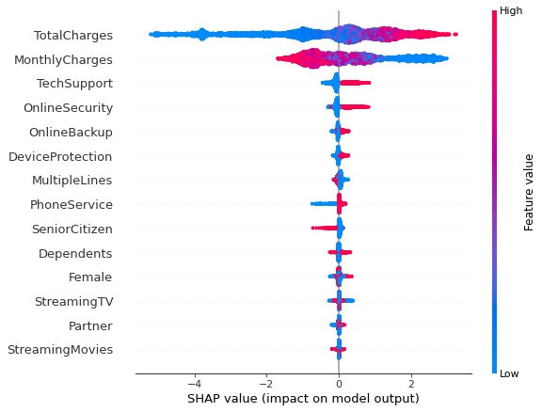
EXPLAINABLE AI using SHAP
SHAP (SHapley Additive exPlanations) is a game theoretic approach to explain the output of any machine learning model.

Slide 26
SOLUTION ACHIEVED

Slide 27
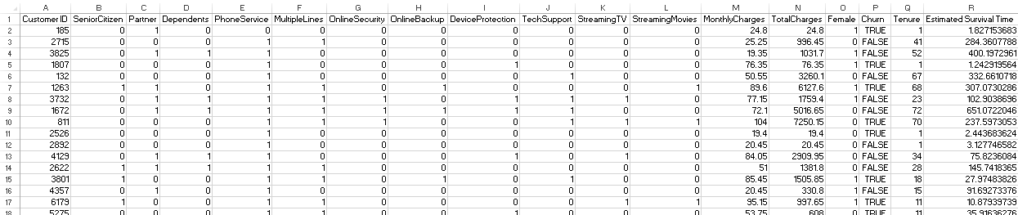
Estimated Survival Time in excel/csv data:

Slide 28
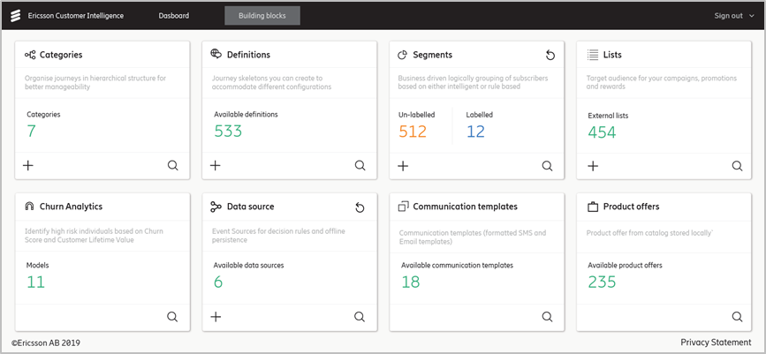
DASHBOARD UI/UX

Slide 29
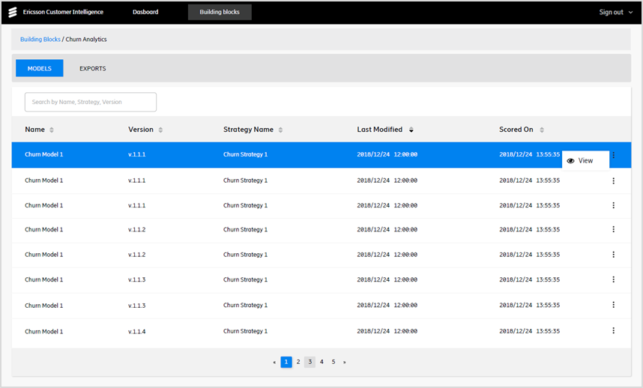
CHURN MODEL LIST

Slide 30
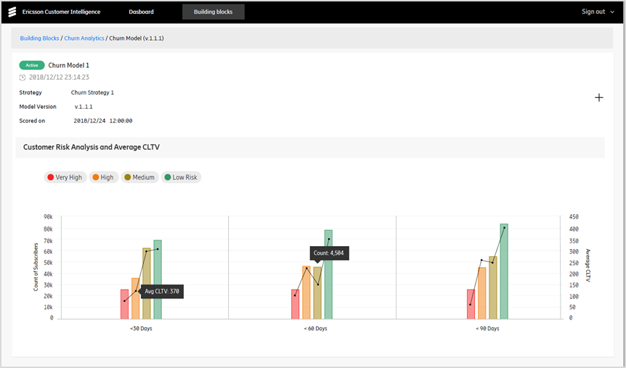
CHURN DISTRIBUTION VIEW

Slide 31
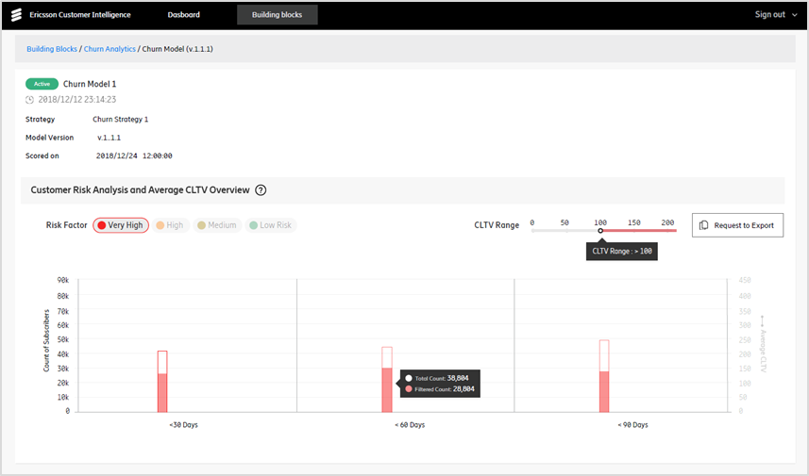
CHURN SEGMENTS BY CLTV

Slide 32
SCOPE OF FUTURE WORK

Slide 33
Machine Reasoning
Further explanation with Explainable AI
Deep Learning
Machine reasoning is a new category of AI/ML technologies
that can enable a computer to work through complex processes that would normally require a human. It is one step ahead of Machine Learning in the sense that the
machine reasons on its own in addition to just learning from past data.
In addition to the Explainable AI implemented in this project, what can be taken into account to authenticate the predictions to decide how good a model can be the Global and Local explainibilities of the model- the former revealing features important for the overall predictions and the latter telling us about which feature was more important for every individual prediction for a particular subscriber.
This project can be extended to use Deep Learning methods and use Artificial Neural Networks for churn prediction and survival time estimation. One can dig deeper into Neural Networks and experiment with them to find what works best for churn prediction.

Slide 34
REFERENCES

Slide 35
[1]Gunjan Bansal, Adarsh Anand & V. S. S. Yadavalli (2019): Predicting effective customer lifetime: an application of survival analysis for telecommunication industry, communications in Statistics - Theory and Methods, DOI: 10.1080/03610926.2019.1570264
[2]Junxiang Lu, Ph.D. Overland Park, Kansas; Modeling Customer Lifetime Value Using Survival Analysis − An Application in the Telecommunications Industry, Paper 120-28, SUGI 28 Data Mining Techniques
[3]Junxiang Lu, Ph.D. Sprint Communications Company Overland Park, Kansas; Predicting Customer Churn in the Telecommunications Industry –– An Application of Survival Analysis Modeling Using SAS; Predicting Customer Churn in the Telecommunications Industry –– An Application of Survival Analysis Modeling Using SAS; SUGI 27 Data Mining Techniques
[4]Barry E. King et Jennifer Rice; Analysis of Churn in Mobile Telecommunications: Predicting the Timing of Customer Churn - AIMS International Journal of Management · August 2019
[5]https://www.ncbi.nlm.nih.gov/pmc/articles/PMC3059453/
[6]https://xgboost.readthedocs.io/en/stable/tutorials/aft_survival_analysis.html
[7]https://arxiv.org/abs/2006.04920
[8]https://www.ucl.ac.uk/short-courses/search-courses/survival-analysis-time-event-data-introduction
[9]https://en.wikipedia.org/wiki/Survival_analysis
[10]https://www.questionpro.com/blog/customer-churn/
[11]https://www.ngdata.com/what-is-customer-churn/
[12]https://www.qualtrics.com/au/experience-management/customer/customer-churn/
[13]https://www.salesforce.com/resources/articles/how-calculate-customer-churn-and-revenue-churn/
[14]https://www.productplan.com/glossary/churn/
[15]https://www.profitwell.com/customer-churn/guide
[16]https://www.youtube.com/watch?v=v1QqpG0rR1k&t=164s
[17]https://www.ericsson.com/en/blog/2021/4/the-characteristics-of-consumer-telecom-bss-stacks-will-prevail-for-enterprises
[18]https://www.ericsson.com/en/telecom-bss
[19]http://www.biecek.pl/statystykaMedyczna/Stevenson_survival_analysis_195.721.pdf
[20]https://medium.com/@zachary.james.angell/applying-survival-analysis-to-customer-churn-40b5a809b05a
[21]https://www.iiap.res.in/astrostat/LecPresentations/JogeshBabu_TruncationCensoring.pdf

Slide 36
Thank you!

